Slide 1




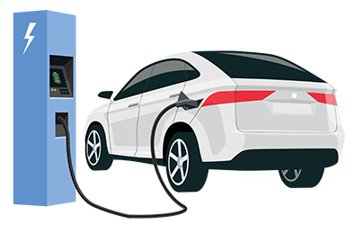
Leverage Data Analytics to determine metrics dictating Electric Vehicle (EV) manufacturing, performance, and purchasing dynamics as an alternative to ICE counterparts
Final Project Presentation
Group : 4
Mohit Agarwal
Abhishek Vaidya
Patrick Shanahan
Tan Phat Bui
16:540:507 Data Analytics Engineering System
Notes:
Presenter: Mohit

Slide 2


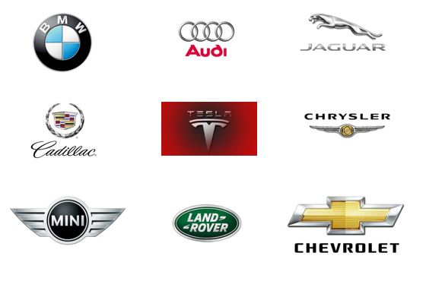
Project Background & Motivation
Over past two decades, Electric Vehicles (EV) Industry has emerged as response to reduce fossil fuel dependency.
Technological advancements have made EV an affordable and sustainable prospect.
Higher initial cost, unfamiliarity from user group to operate alternative technologies and lack of awareness poses challenge in expansion of EV market.
In this project, we set out to explore the myths and facts about EV: Are they affordable? Sustainable? Energy Efficient? Maintenance friendly? Do they perform comparably to ICE vehicles?
A data analytics driven approach is undertaken to analyze EV landscape by asking probing questions about its acceptance and prospects.
Lastly, As Case study - Data analytics & visualization used to recommend suitable EV vehicle for residents of New Jersey to propel the clean energy movement.
Notes:
Presenter: Mohit

Slide 3
Key Questions : Goal of the Study
After studying the datasets objects and attributes following questions are identified for exploration:
Will EV become affordable in future? Estimate ownership costs between ICEs and EVs using linear regression to predict whether EV is a cost-effective option?
Are EVs are more sustainable than ICE vehicles? Which EVs are most energy efficient? Use classification and logistic regression to estimate if EV could lead to cleaner transport.
Which attributes determine EV pricing? Use LR / PCR to predict critical features and enable potential buyer make informed purchase keeping these attributes in consideration.
If you like the idea of owning an EV, Who is the best maker and what is the best model out there for you? Data visualization tools & clustering used to identify best performing models and put forward recommendations based on analysis results.
Are there similarities across EVs model segments? Use cluster/ KNN classification analysis to categorize. Lastly, evaluate progress made in EVs sector in terms of their technical advancement.
Notes:
Presenter : Abhishek

Slide 4
Questions & Answers /Conclusion: Summary
Analysis Objective | Conclusion
EV vs ICE cost Analysis | Clearly indicated decreasing cost trend for EVs.
Are EVs sustainable? | EV classified into the favorable GHG score category (as per set threshold). Hence, sustainable.
Which attributes would determine EV pricing? | Three regression equation, based on EV categories yielded price predictor equations.
What are the best EV options out there? | Q3 and Q4 busiest sales region. Tesla, BMW, Ford, Toyota, Chevrolet best makers in NJ. For mid Range and pricing bracket Tesla model : X, S and 3 best performers. Similar trends on the US Scale too.
Can similarities between EV be mapped? How to group them? | As per “CombE” metric, Tesla had best numbers. Best models in mid-size and large-size segment clustered based on Range and CombE metric.
Notes:
Presenter : Phat

Slide 5
Dataset Introduction
Total 8 datasets files were used in the project.
Sources: Gov catalog for EV vehicle inventory (AFDC energy.gov and Fuel economy.gov), Kaggle, Open-source web publishers (Inside EV, Atlas EV hub)
These sources were chosen because they were most reliable open-source of information to get structured data for EV industry both at US (National level) and NJ (state-level)
Each dataset file contains multiple spreadsheets and total number of variables 250 variables. But these attributes were filtered as needed and will be described in respective model analyses sections.
Date Ranges: Some of the files had very recent data (from 2000 till 2021) while some of the dataset had historical information (from 1980s till 2010s). Of course, these datasets were trimmed and filtered in Data cleaning + pre-processing step before importing for models and visualization code files.
Notes:
Presenter: Patrick
Introduce all 8 datasets

Slide 6
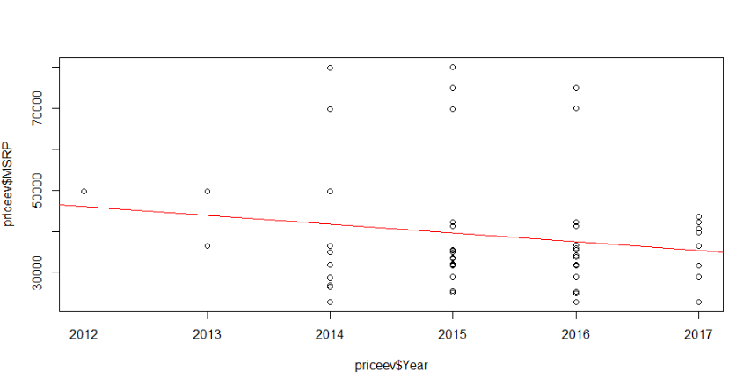
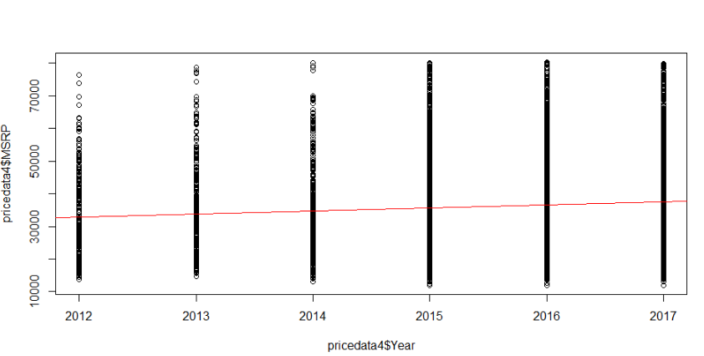
EV vs ICE cost Trend Analysis
Data from Kaggle provided by Edmunds and Twitter
Goal: Simple linear regression to help project price of electric and internal combustion engine vehicles (EV & ICE)
Data Cleaning: Removed outliers and separated data
Vehicle Segment | Simple Regression Model
Electric Vehicles | 4,328,731 – 2,129X₁
Internal Combustion Engine (ICE) Vehicles | -1,903,449.8 + 962.3X₁
EV Pricing Trend
Conclusion: EVs show a downward trend in cost and ICEs show a slight upward trend in price.
ICE Pricing Trend
Notes:
Presenter : Pat

Slide 7
Are EV Eco-Friendly Vehicles? Step: Data Collection
Goal - Create a logistics regression to classify environmentally friendly vehicles among ICEs, Hybrids and EVs
Data Overview:
ghgScore: Green House Gas Score
Barrels08: Annual petroleum consumption in barrels
Comb08: Combined Miles Per Gallon
feScore: EA fuel economy score
City08: city Miles Per Gallon
UCity: Unadjusted city Miles Per Gallon
Highway08: highway Miles per Gallon
Uhighway: Unadjected highway Miles Per Gallon
Notes:
Presenter : Phat

Slide 8
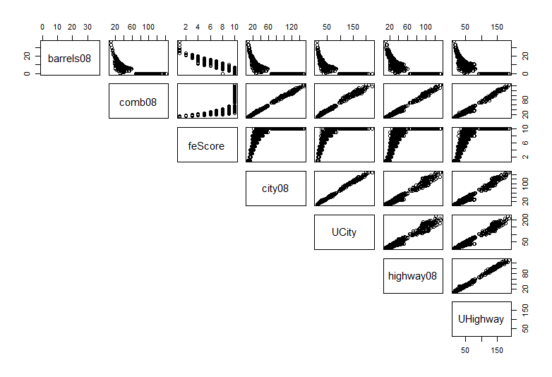
Classify Eco-Friendly Vehicles:Data Cleaning
Create Vehicle_Type using Fuel_Type:
Gas -> ICE
Gas and Electricity -> Hybrid
Electricity -> EV
Convert ghgScore (1-10) to binary variable ghgScoreY
Average = 4.7
Good (1) > 4.7
Bad (0) < 4.7
Eliminate Uhighway, highway08, Ucity attributes
Build logistics regression using 3 remaining attributes
Split training and testing data (70/30)
Correlation Matrix
Notes:
Presenter : Phat
141 observations with data, removing observations with missing data = 107
Removed outliers from MSRP 106 observation
To run regression analysis looked at correlation matrix to remove correlated attributes - left 30 Attributes

Slide 9
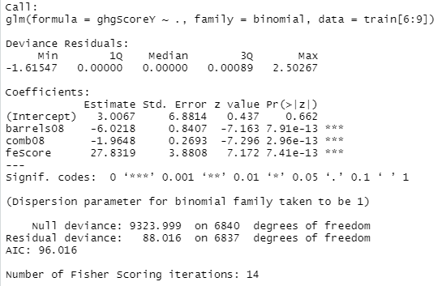
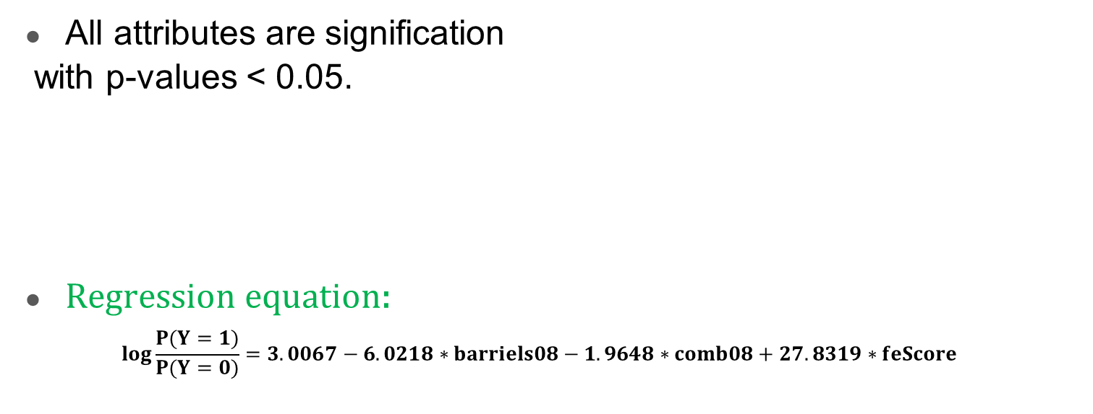
Logistic Regression Analysis Outcomes:
Model Summary
All attributes are signification
with p-values < 0.05.
Regression equation:
$$log\frac{P(Y=1)}{P(Y=0)}=3.0067−6.0218∗barriels08−1.9648∗comb08+27.8319∗feScore$$
Notes:
Presenter : Phat

Slide 10
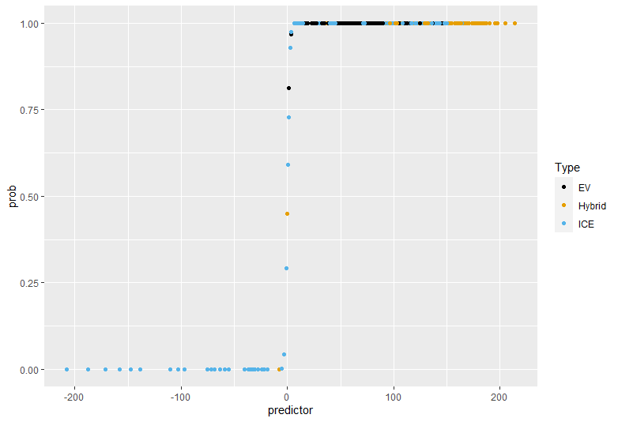
Are EV sustainable option? : LR Visualization
Most EVs and Hybrids have good ghgScore
Most ICEs have low ghgScore
However, there are some ICEs with good ghgScore and some Hybrids with low ghgScore
EVs clearly offer favorable GHG emission metrics and thus a step towards cleaner and sustainable transportation.
Accuracy for Training set = 0.99707
Accuracy for Testing set = 0.99931
Accuracy for both Training and Testing data sets are high
=> Good logistics regression model
Notes:
Presenter : Phat

Slide 11
EV Price Predictors: Determine key attributes
Goal: Create a multiple regression and principal component (PCA) model to help predict the price or attributes of electric vehicles (EVs)
Data Collection
Dataset collected from www.fueleconomy.gov
Data provided information on many attributes for many type of vehicles and had data over many years
Attributes including charge time, range, drive, model, vehicle class, type of charger, etc. ~ 83 attributes
Data Cleaning:
Dataset included internal combustion engine (ICE) and EV data
Removed columns with null values for EVs and filtered EVs from the dataset
Used www.motortrend.com and www.evspecifications.com to pull additional attributes including the original MSRP, battery capacity, acceleration, top speed, and horsepower
Removed outliers from MSRP
44 attributes and 106 observations with complete data
Notes:
Presenter : Patrick
Office of Energy Efficiency and Renewable Energy, Official US Gov source for fuel economy data.
Other data sources did not list the year range or on had data for a single year or had limited vehicle models to work with.
Used the last 5 years worth of data
141 observations with data, removing observations with missing data = 107
Removed outliers from MSRP 106 observation

Slide 12
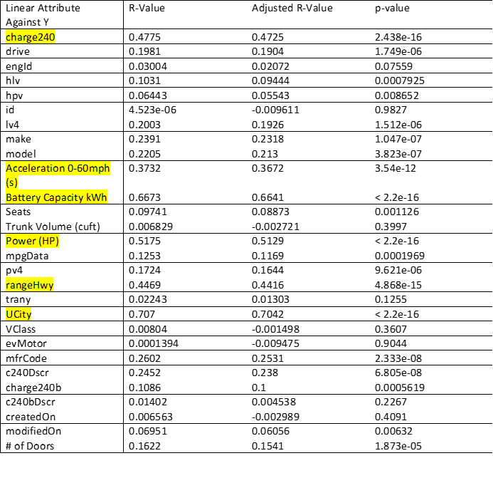
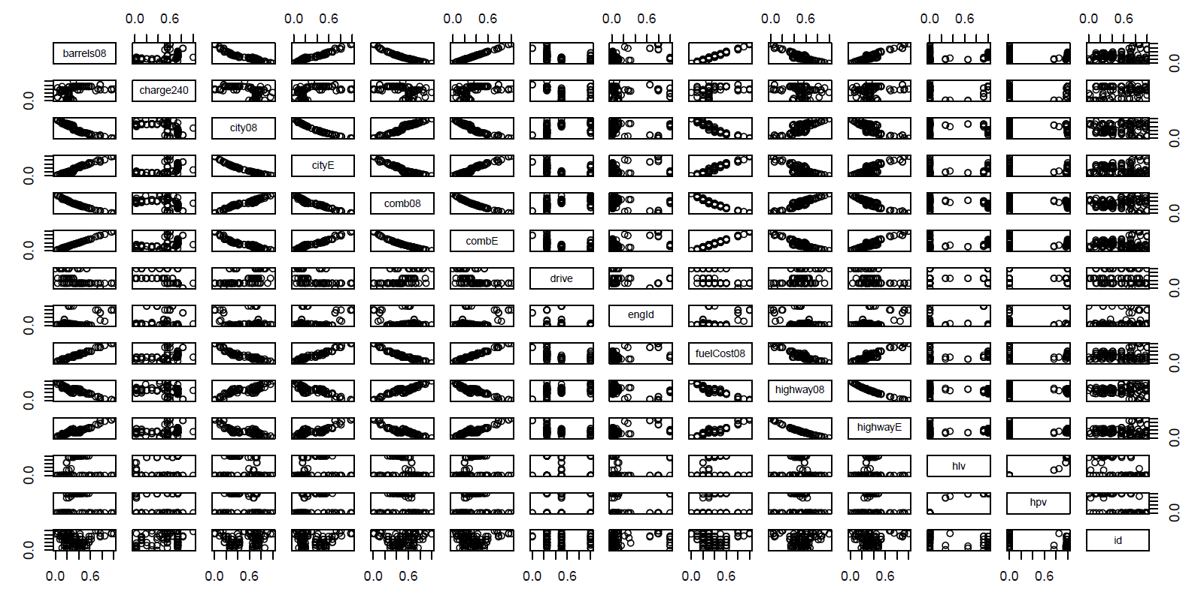
EV Price Predictors: Data Cleaning
Correlation matrix
Checking linear relationships between Y & Xi
Removed attributes < 0.3 R-sqd
44 ⇒ 7 Attributes
Notes:
Presenter : Patrick
To run regression analysis looked at correlation matrix to remove correlated attributes - left 30 Attributes

Slide 13
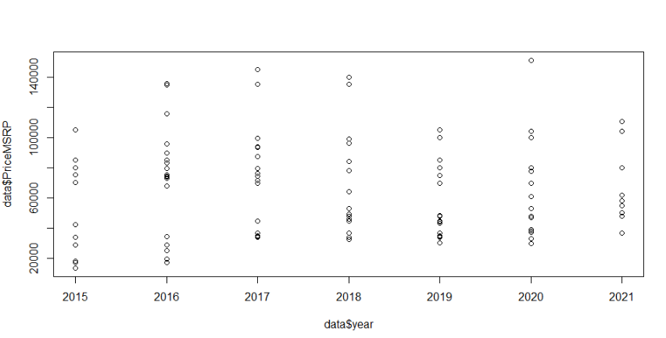
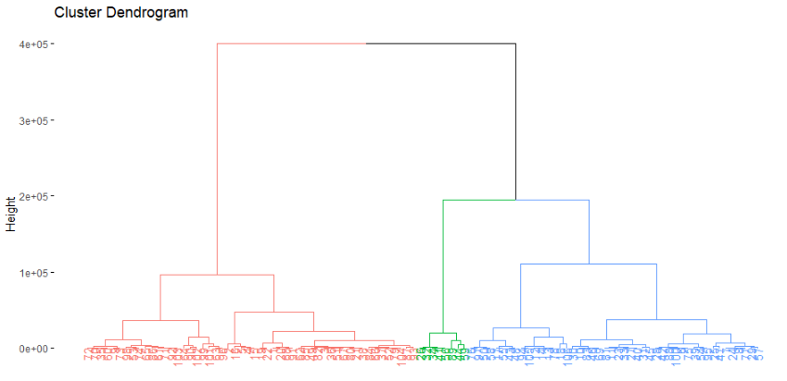
EV Price Predictors: Hierarchical Clustering
Notes:
Presenter : Patrick
To make regression more accurate clustered data

Slide 14
EV Price Predictors: Analysis & Conclusion
Forward stepwise function in R studio using > 0.05 p-value threshold
Cluster Name | # of Observations in Cluster | MSRP Range within Cluster | Linear Attributes from Stepwise Function | R² | Adj-R² | P-Value | Root Squared Means Error | Residual standard error | Final Model
Cluster_1 | 52 | 13,580-64,000 | Power HP | 0.56 | 0.55 | 2.307e-10 | 7,724.13 | 7,877 | 17,071.37 + 110.28X₁
Cluster_2 | 46 | 68,000 – 115,500 | Acceleration 0-60mph (s), UCity, rangeHwy | 0.56 | 0.53 | 1.501e-07 | 8,573.13 | 8,972 | 14,8627.06 + (-962.12X₁) + (-552.29X₂) + ( 87.03X₃)
Cluster_3 | 8 | 134,500-150,900 | UCity | 0.79 | 0.76 | 0.003117 | 3,028 | 2,622.45 | 20,0307.1 + (-528.5X₁)
Three multiple Linear Regression models since single LR model can’t cover all EV segments
Notes:
Presenter : Patrick
UCity shows up twice
HP and acceleration are for speed = more important than other metrics like how a car looks or the style

Slide 15
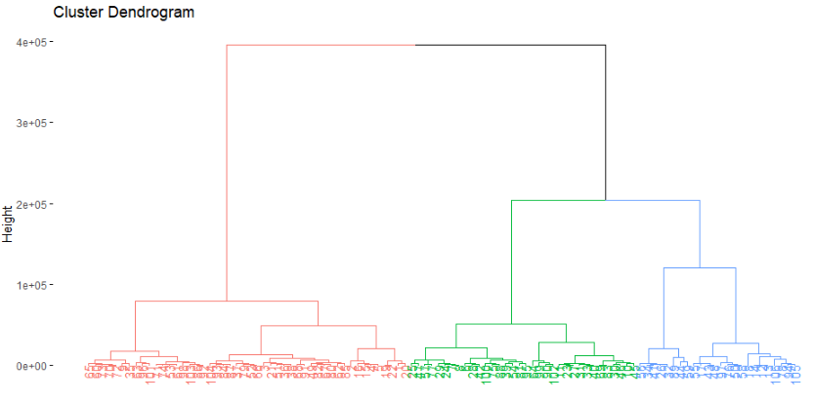
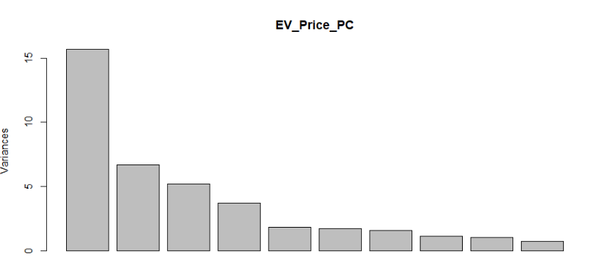
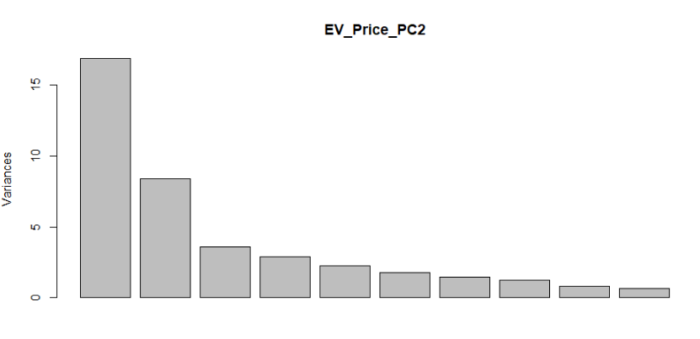
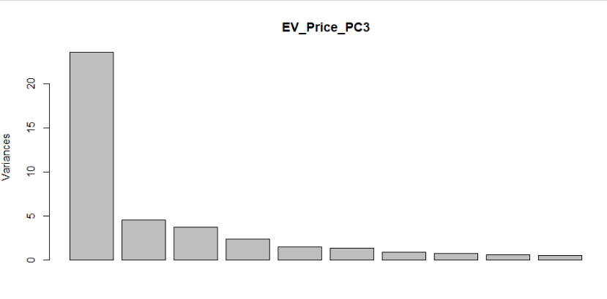
EV Price Predictors: Using PCA
Hierarchical Clustering to define groups
Principle component test for each cluster
Notes:
Presenter : Patrick
Clustered the groups slightly differently b/c cluster analysis was run on data with all 44 variables instead of the trimmed down dataset previously.

Slide 16
EV Price Predictors: PCA Results
Summary Table
Cluster | # of Observations in Cluster | MSRP Range within Cluster | Principle Components | R² | Adj-R² | P-Value | Root Squared Means Error | Residual standard error | Final Model
Cluster_1 | 48 | 13,580 - 54,990 | PC1-PC4 | 0.52 | 0.47 | 1.922e-06 | 6,953.87 | 7,347 | 37,076.97917 + 1,369.08X₁ -70.53X₂ -1,552.94X₃ + 1,704.29X₄
Cluster_2 | 34 | 57,990 – 89,500 | PC1-PC5 | 0.66 | 0.60 | 7.376e-06 | 4,483.02 | 4,940 | 75,837.6 – 181.2X₁ – 554.6X₂ – 2,519.4X₃ + 1,793.1X₄ – 1,447.4X₅
Cluster_3 | 24 | 93,500 - 150,900 | PC1-PC4 | 0.67 | 0.60 | 0.0002146 | 10,569 | 11,880 | 11,4219.6 - 405.4X₁ + 1,763.9X₂ – 1,312.7X₃ + 9,322.9
Three multiple Linear Regression models since single LR model can’t cover all EV segments
Notes:
Presenter : Patrick

Slide 17




So, EVs are getting cheaper and proving sustainable, Great!! Next Question that pops up: How do I identify a right Model and Maker!? What makes them a great prospect?
Notes:
Presenter : Mohit

Slide 18
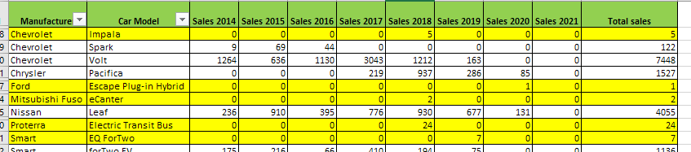
EV Market Analysis: Data Cleaning Step
Merging data of years to get total sales or aggregate values. (particularly useful in Classification, Comparison, regression, PCA and clustering analysis). See sample below:
Eliminating missing data (objects and attributes as needed to eliminate NaN error in code)
Removing redundant or insignificant variables (for scope of analysis). See yellow highlighted column headers below:
Some rows with many null values or skewed/ outlier values eliminated.
Notes:
Presenter : Mohit

Slide 19
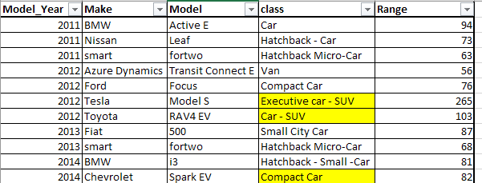
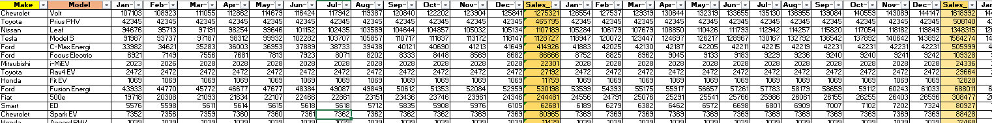
Data Cleaning
Data Normalization (scaling attribute values) for classification and clustering (converting multi-variate attribute to Boolean attributes). (Implemented in Dataset # 6 and 8)
Consolidation of attribute categories and labels so that better classification can be obtained. See sample below (from Data set file #4):
Re-defining the scope of the date range in the dataset to only consider recent years of sales data. In Data set file # 1, 5, 6 and 8 – we had to trim down the year range so that only recent 3 to 5 years data is included in the analysis model.
Notes:
Presenter : Mohit

Slide 20
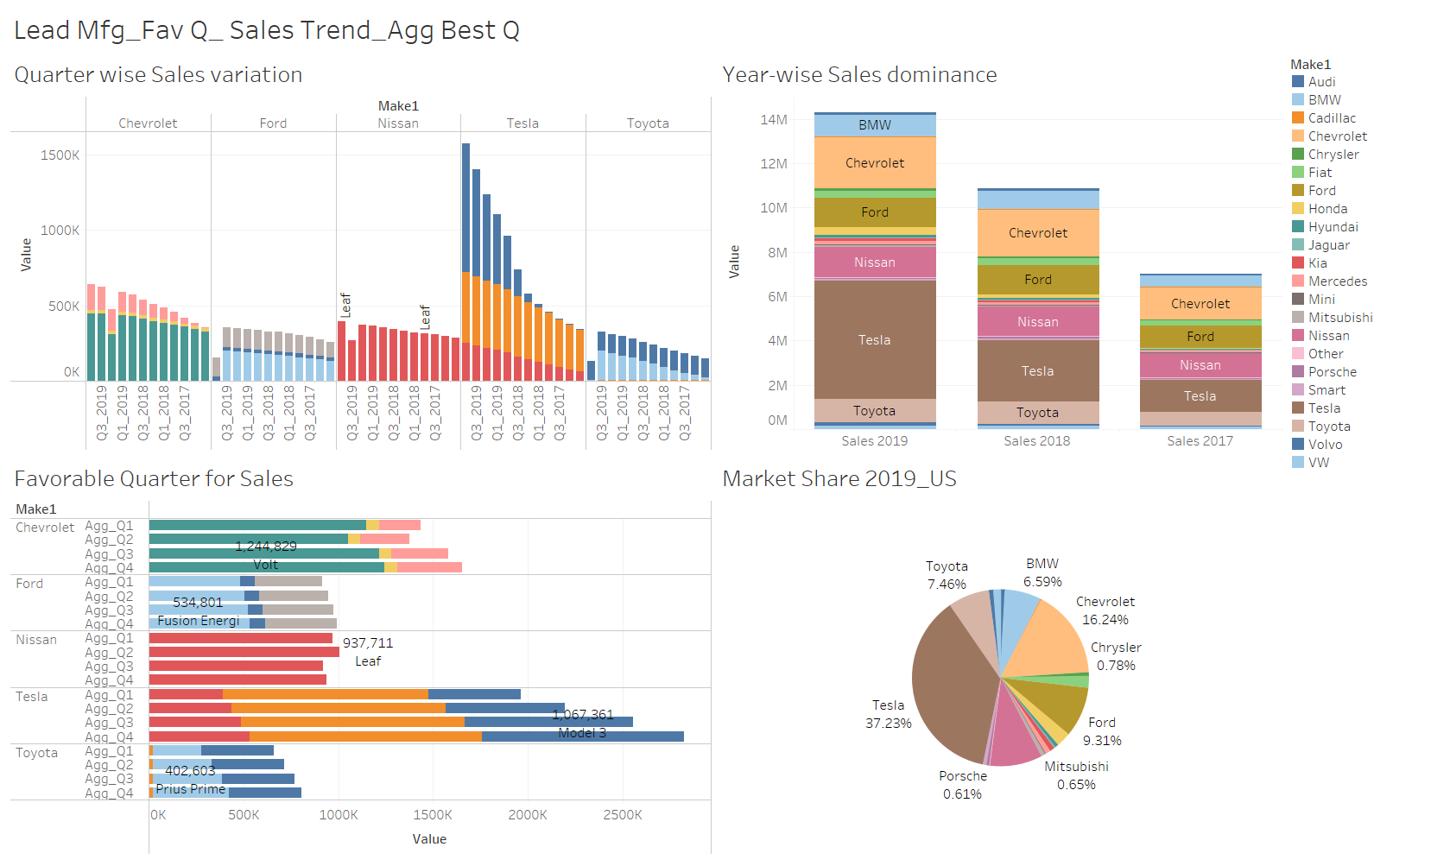
Electric Vehicle Sales US Trends (2017 to 2019)
Major makers and sales trend
Q3 and Q4 had the most sales.
Agg Q4 highest sales.
Notes:
Presenter : Mohit

Slide 21
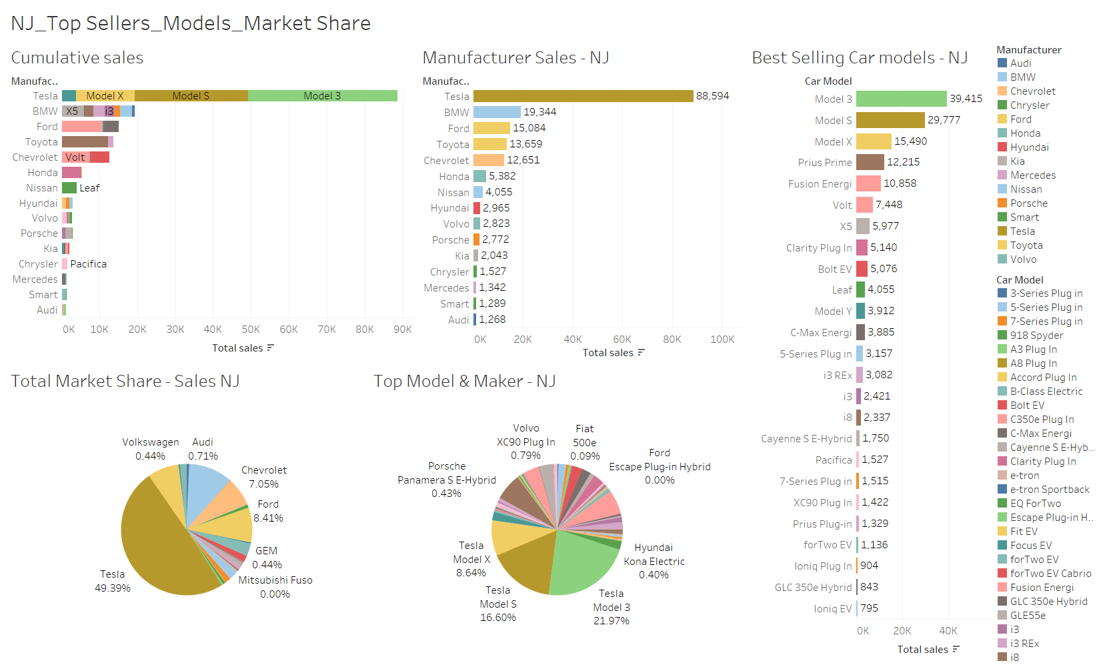
NJ Top Sellers, Models & Market Share Trends
Model 3, Model S and Model X emerge as biggest sellers in NJ region
Notes:
Presenter : Mohit

Slide 22
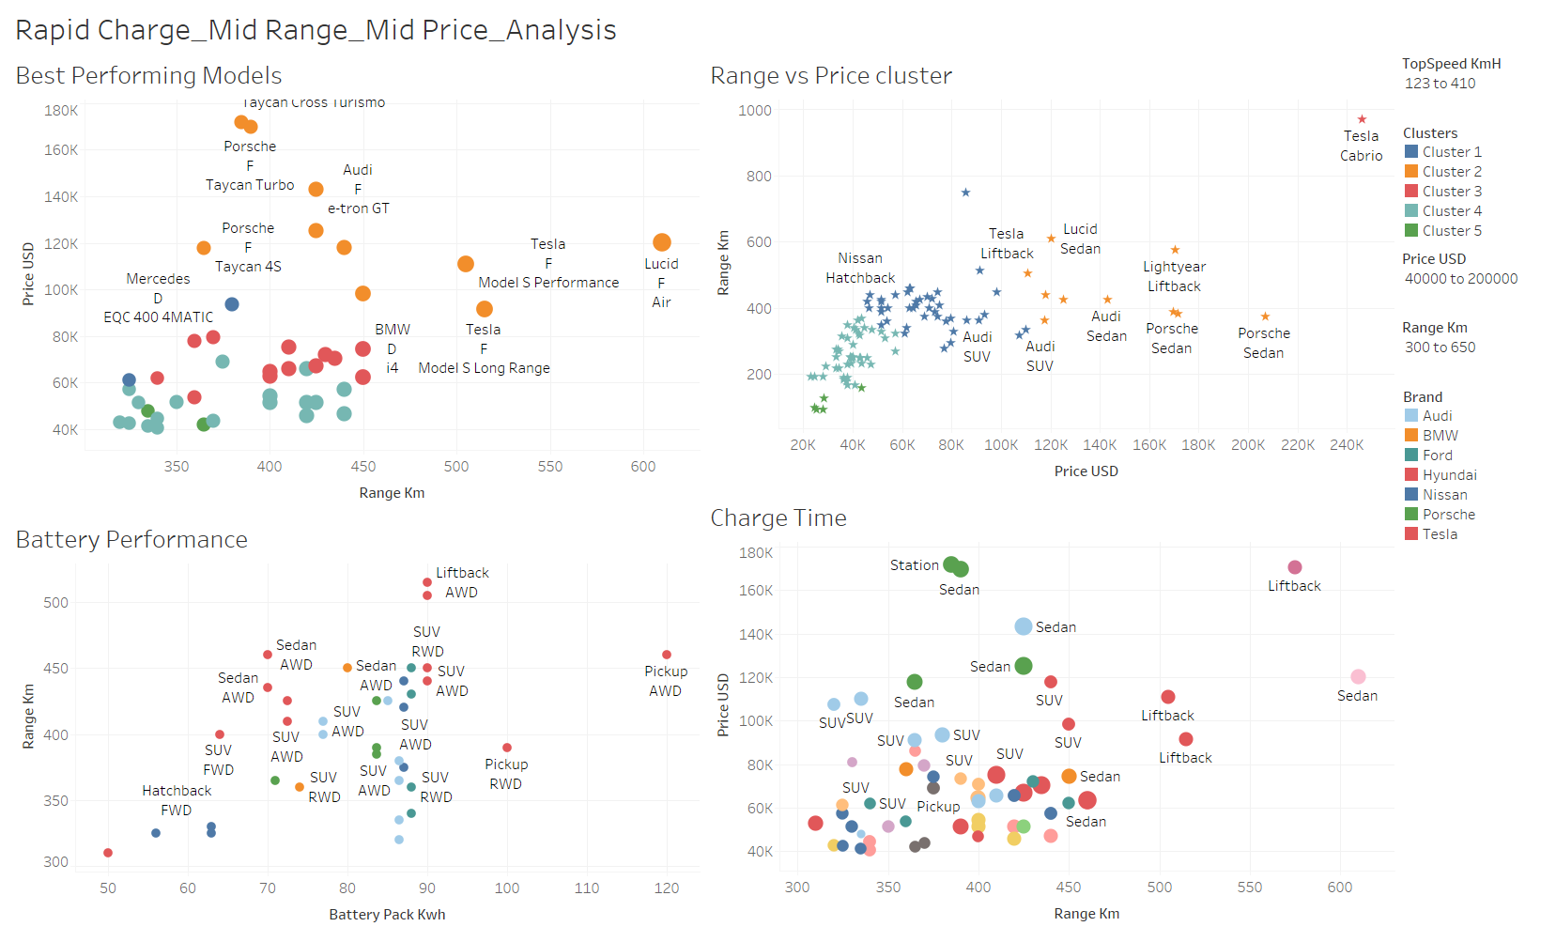
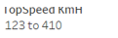
Rapid Charge, Mid Range & Mid price EV Segment Analysis
Hatchback, Sedan and SUV good (cluster 4&5) mid-range EV options
Budget of 60-80K yielding several good range EV options (Class C, D, E)
Class
A: Mini cars
B: Small cars
C: Medium-size cars
D: Large cars
E: Top class cars
F: Luxury cars
J: SUV with sports equipment
M: MPV (Multi-purpose)
S: Sports vehicle
AWD popular option for mid-range EV
SUV, Sedan, Hatchback, Liftback and Pick-up body style
Notes:
Presenter : Mohit

Slide 23
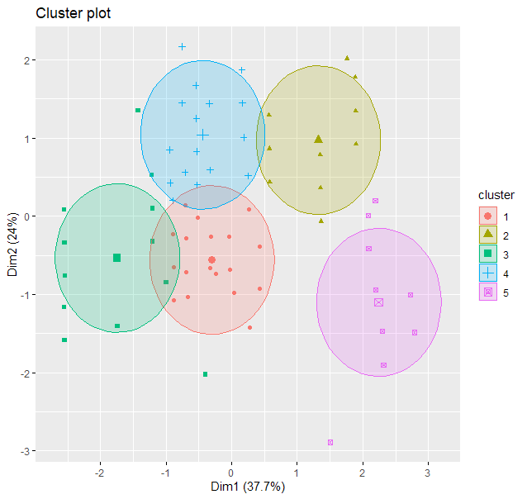
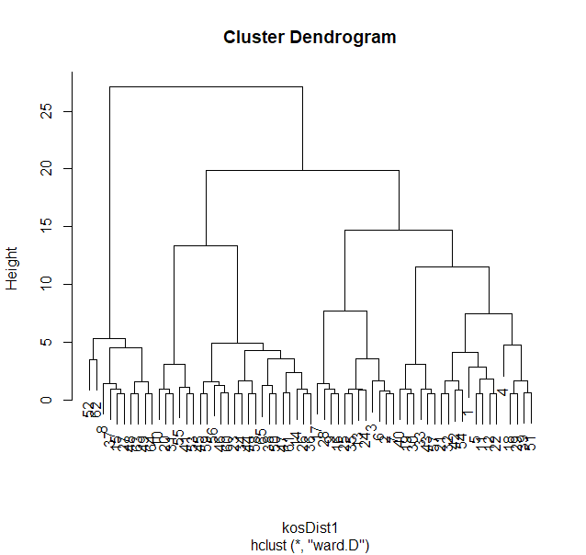
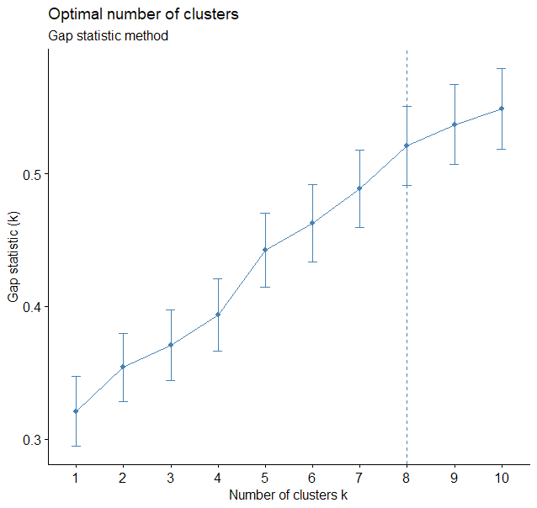
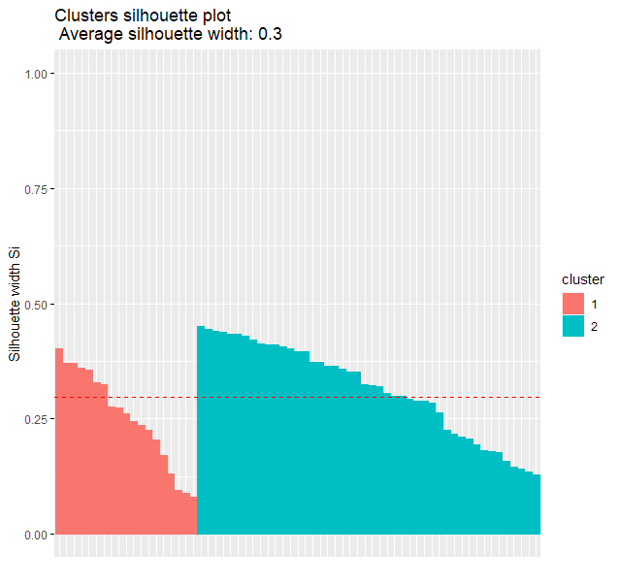
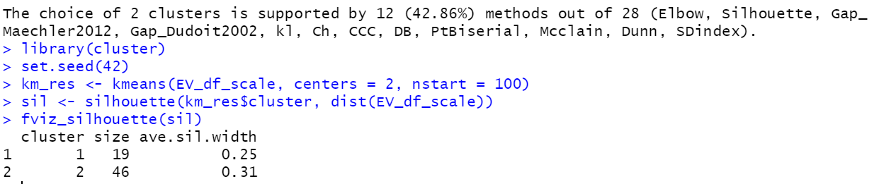
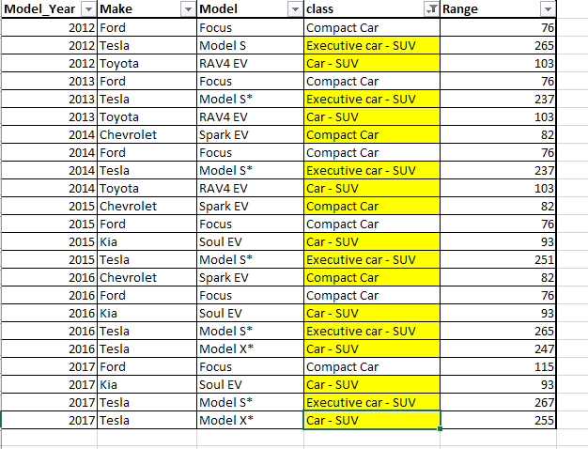
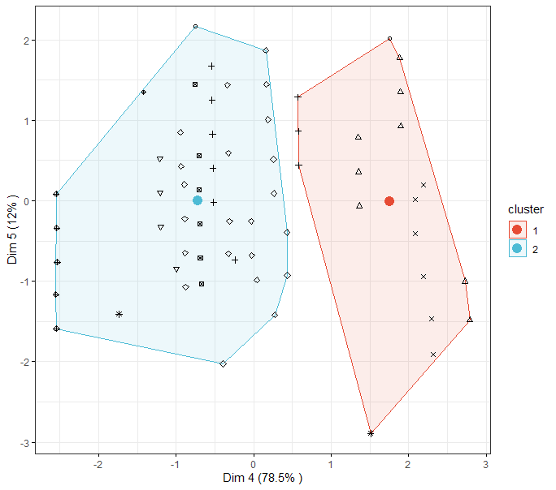
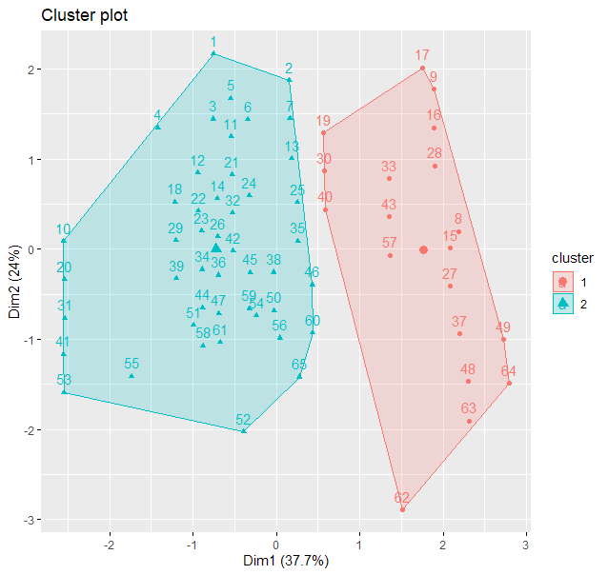
Clustering Analysis in R: Range, Price, Maker & Year critical attributes
EV Range base attribute chosen to cluster EV into known body styles / classes. Similar classification (as Tableau) was realized.
The congruency of results showed that even with varied data sources – Range, price, maker and year emerge as critical attributes
Notes:
Presenter : Mohit

Slide 24
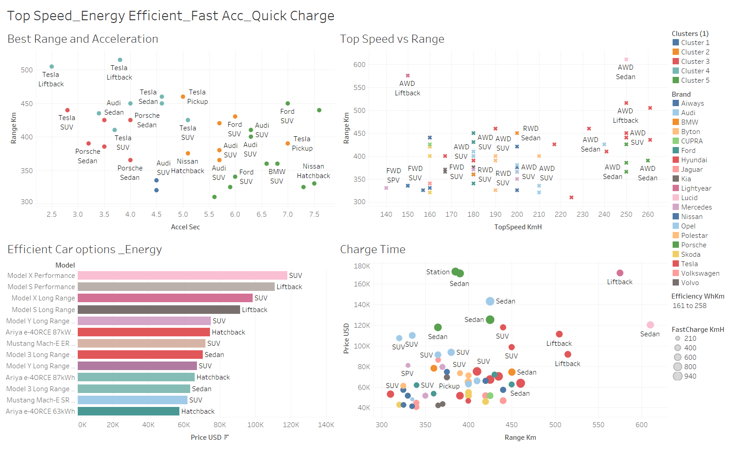
Top Speed, Energy Efficient & Fast Accuracy, Quick charging EV specs Analysis
Tesla clearly offers quicker acceleration time.
AWD Sedan and SUV mid-range EV with best top speed
SUV, Hatch back and Pickup body style with optimal charge time and mileage for given price range
Tesla offers most energy efficient EVC.
Notes:
Presenter : Mohit

Slide 25
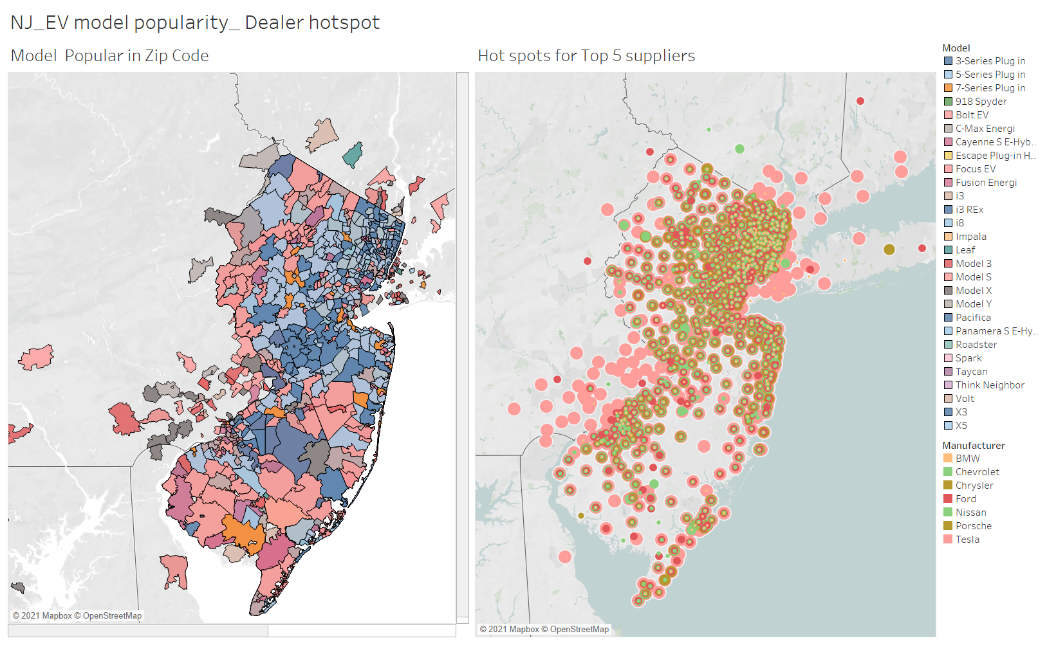
NJ_EV model popularity and Dealer Hotspots zonal mapping
This indicates Model “3-series plug in” most popular model in that county
Tesla
While other top makers are more concentrated in North and central NJ. Tesla as market leader shows greater dealer footprint
Notes:
Presenter : Mohit

Slide 26
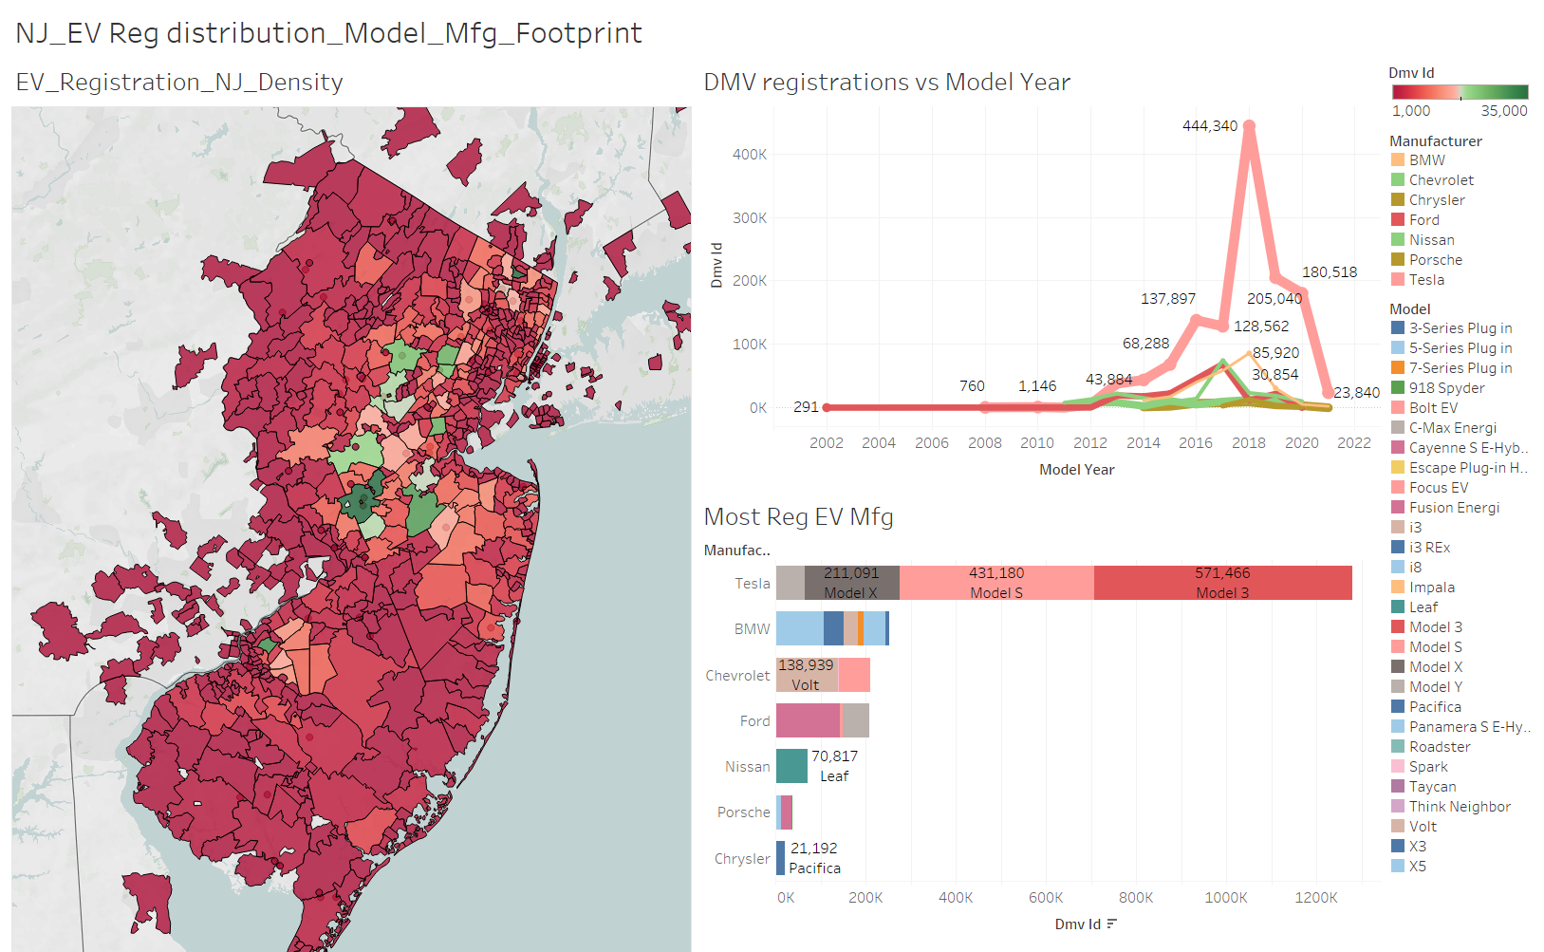
NJ_EV Registration and Model + Makers Sales Distribution
DMV - EV Reg count
Density plot highlighting Zip code as per the EV Registration counts
DMV - EV Reg count
DMV - EV Reg count
Notes:
Presenter : Mohit

Slide 27
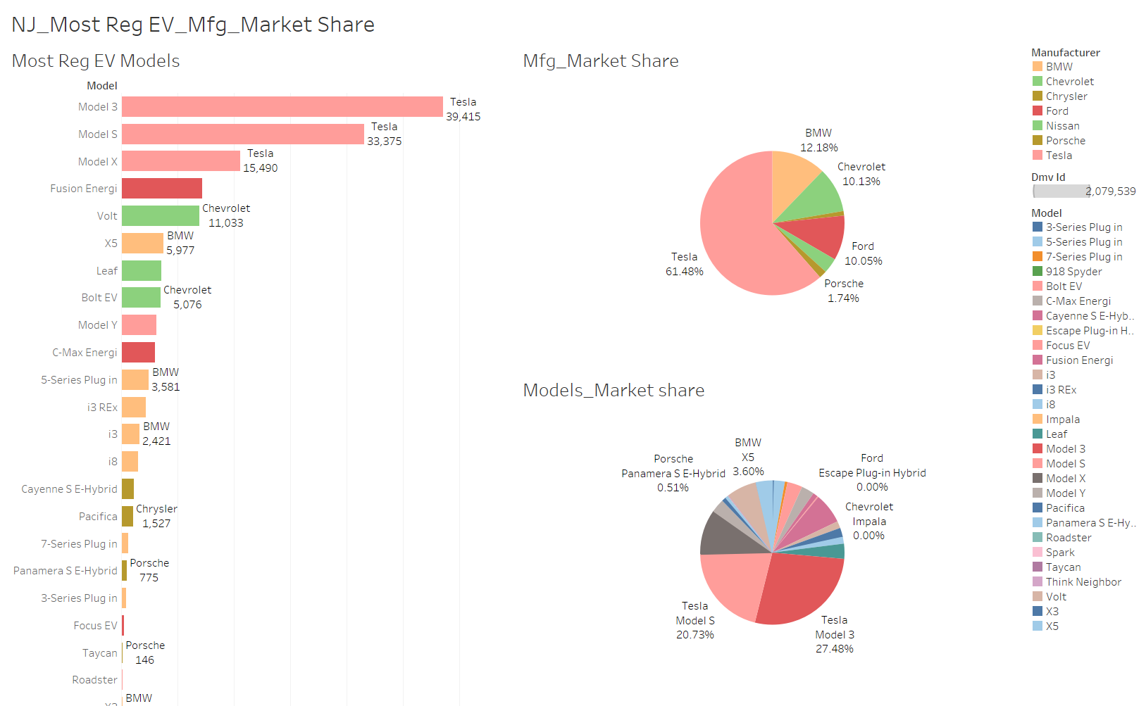
Based on DMV data: NJ EV - Model Popularity, Maker and model market share
As evident, DMV registration data concurs with analyses presented in previous slides about most popular model EV cars and reliable manufacturers.
Notes:
Presenter : Mohit

Slide 28
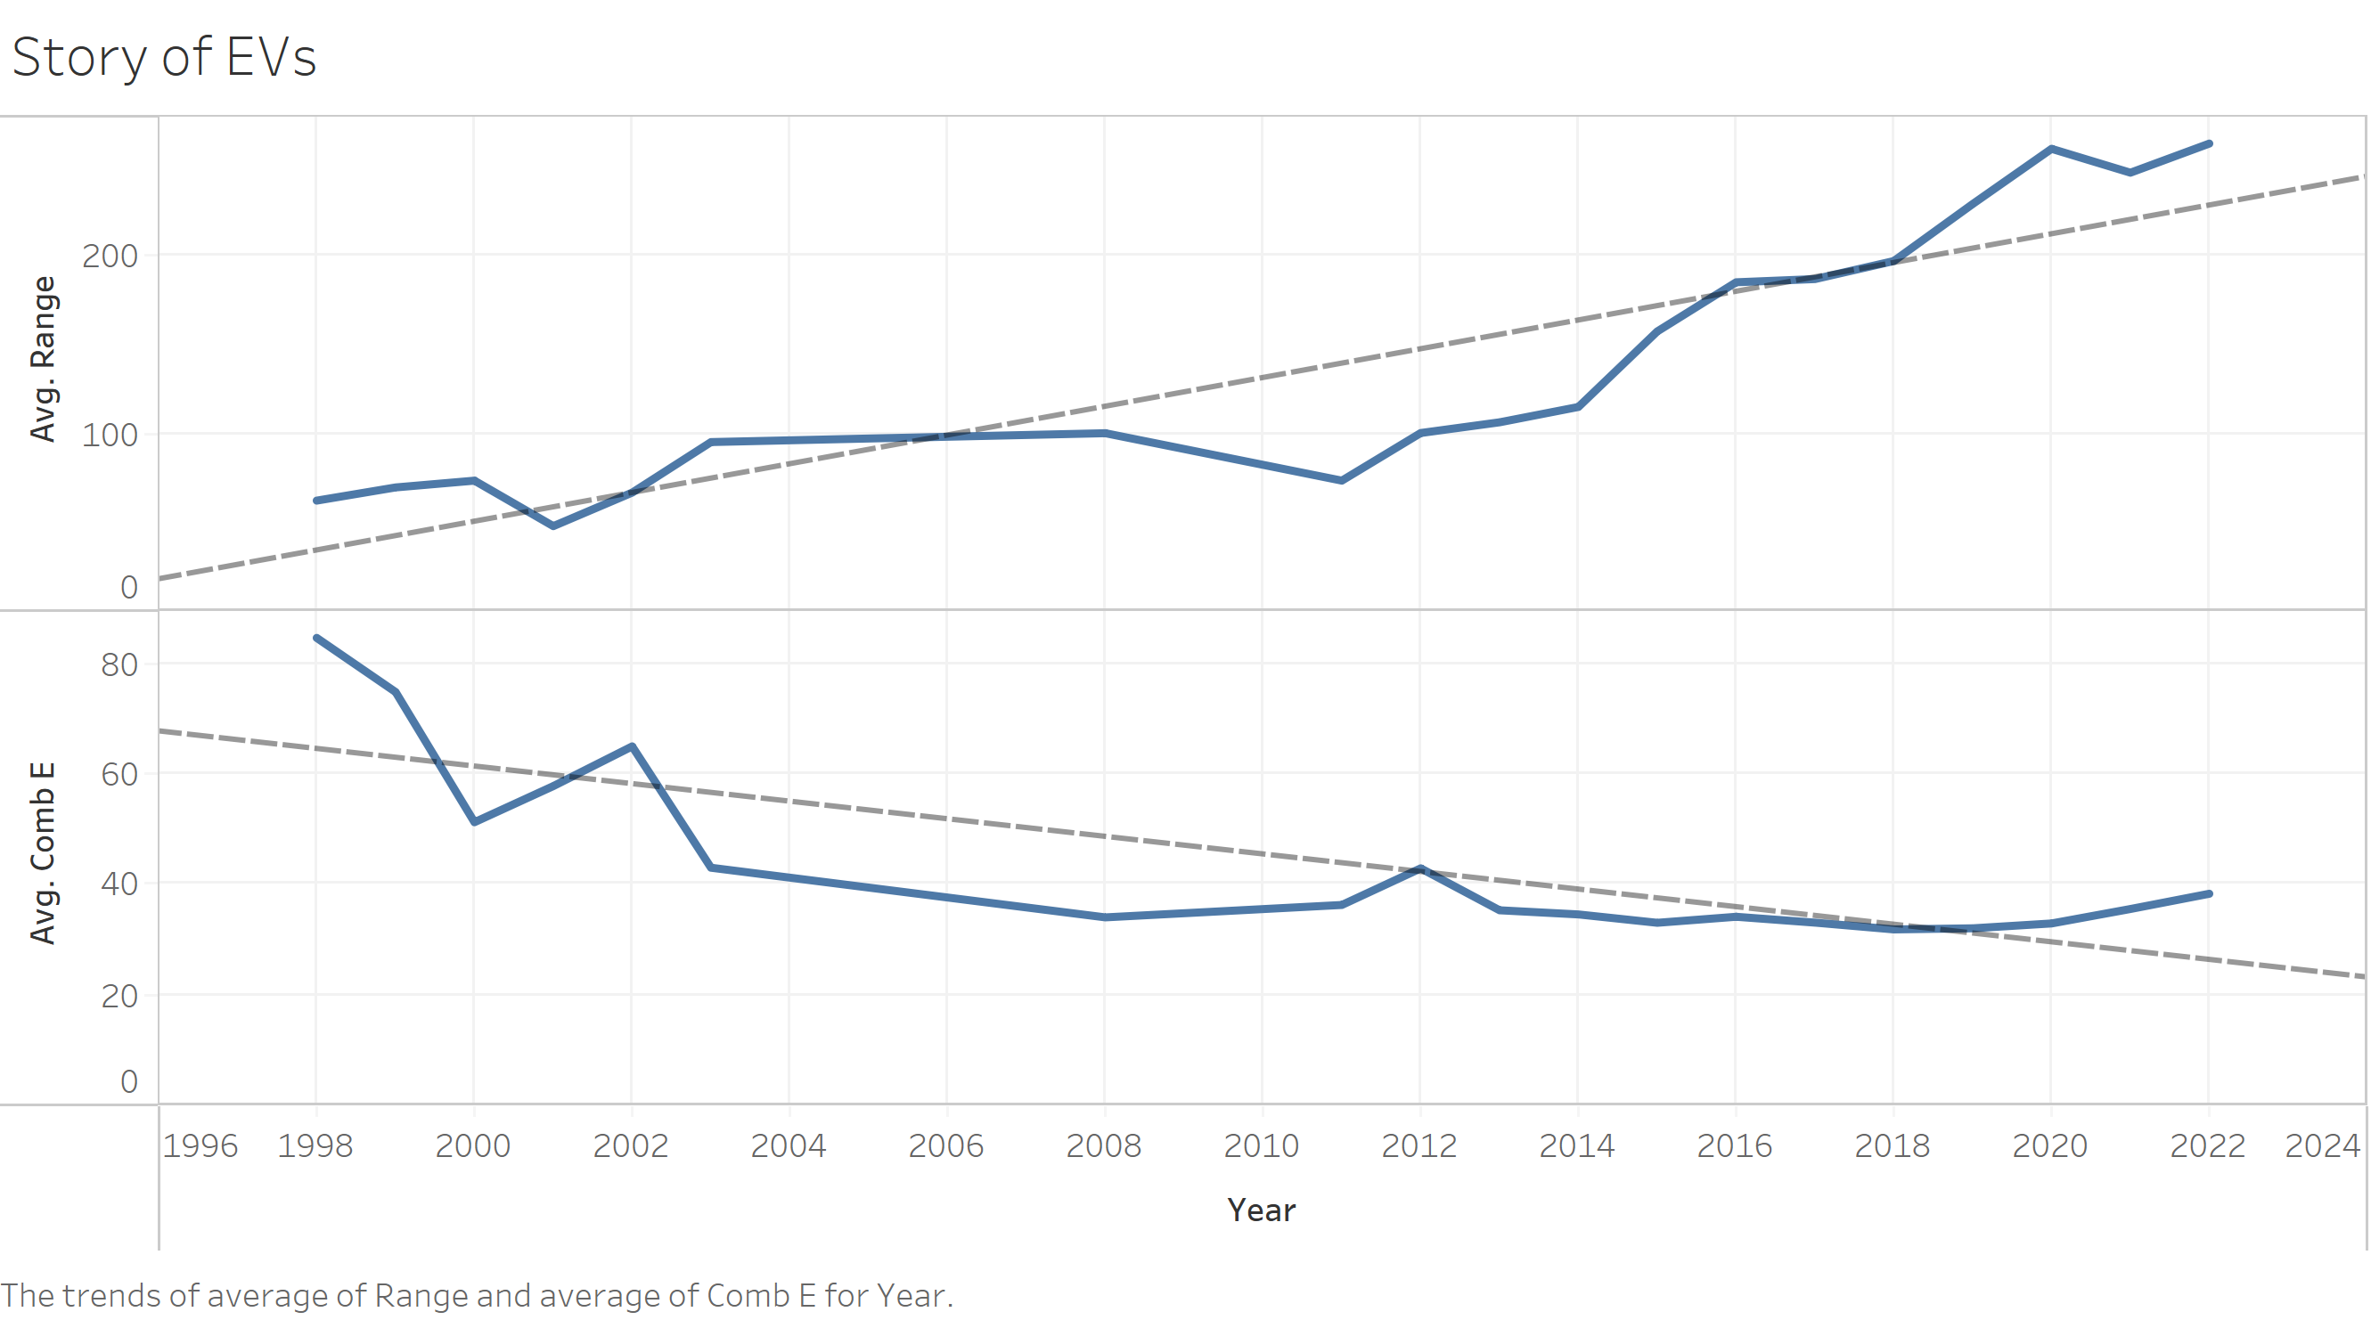
How Far EVs have come
Notes:
Presenter : Abhishek
Range in Miles
Comb E combined electricity consumption in kw-hrs/100 miles

Slide 29
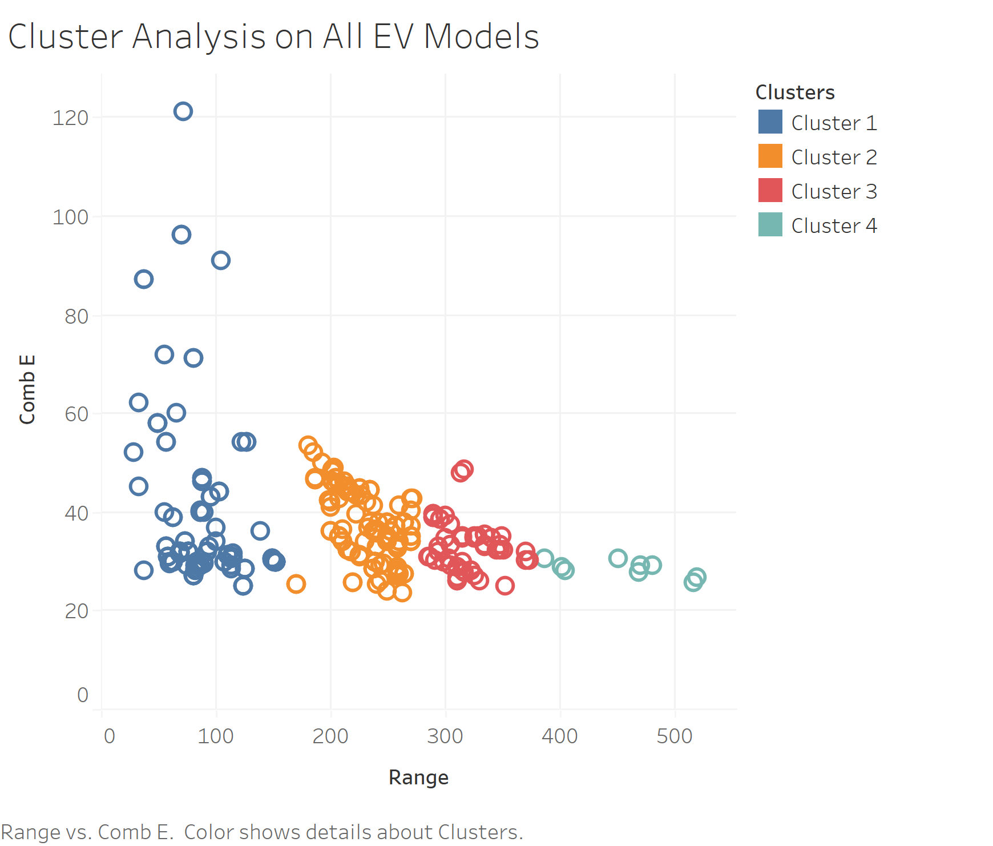
Comparing All the EVs
Notes:
Presenter : Abhishek

Slide 30

What's in the clusters?
Cluster 1(Poor): GMC- EV1-Two Seaters-Consumption=40-Range=55
Mercedes-Benz- B-Class Electric Drive Midsize Cars-Consumption=40-Range=87
Cluster 2(Good): Audi RS e-tron GT Midsize Cars -Consumption=41.8433 Range=232
Porsche Taycan Perf Battery Compact Cars Consumption=42 Range=200
Cluster 3(V. Good): Tesla Model S Long Range Large Cars Consumption=30.2726 Range=373
Tesla Model Y Performance AWD Small Sport Utility Vehicle 4WD Consumption30.3534 Range= 291
Cluster 4(Best): Lucid Air Dream P AWD w/21in wheels Large Cars Consumption=30.4704 Range=451
Tesla Model S Performance (19in Wheels) Large Cars Consumption=30.569 Range=387
Notes:
Presenter : Abhishek

Slide 31
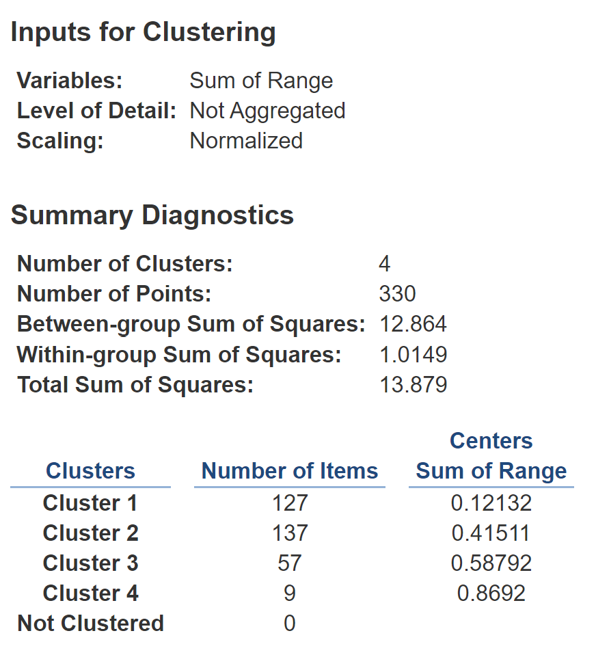
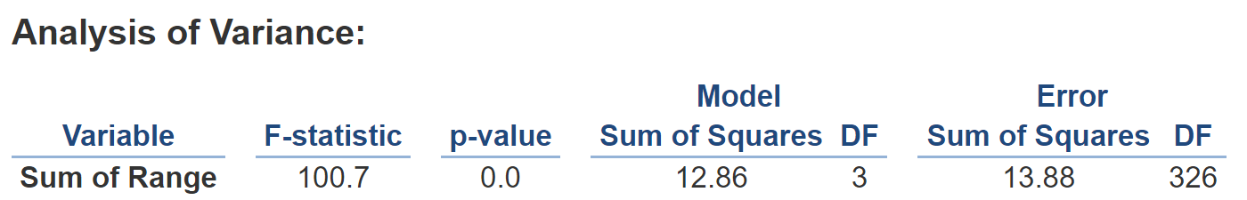
Cluster Analysis
Notes:
Presenter : Abhishek

Slide 32
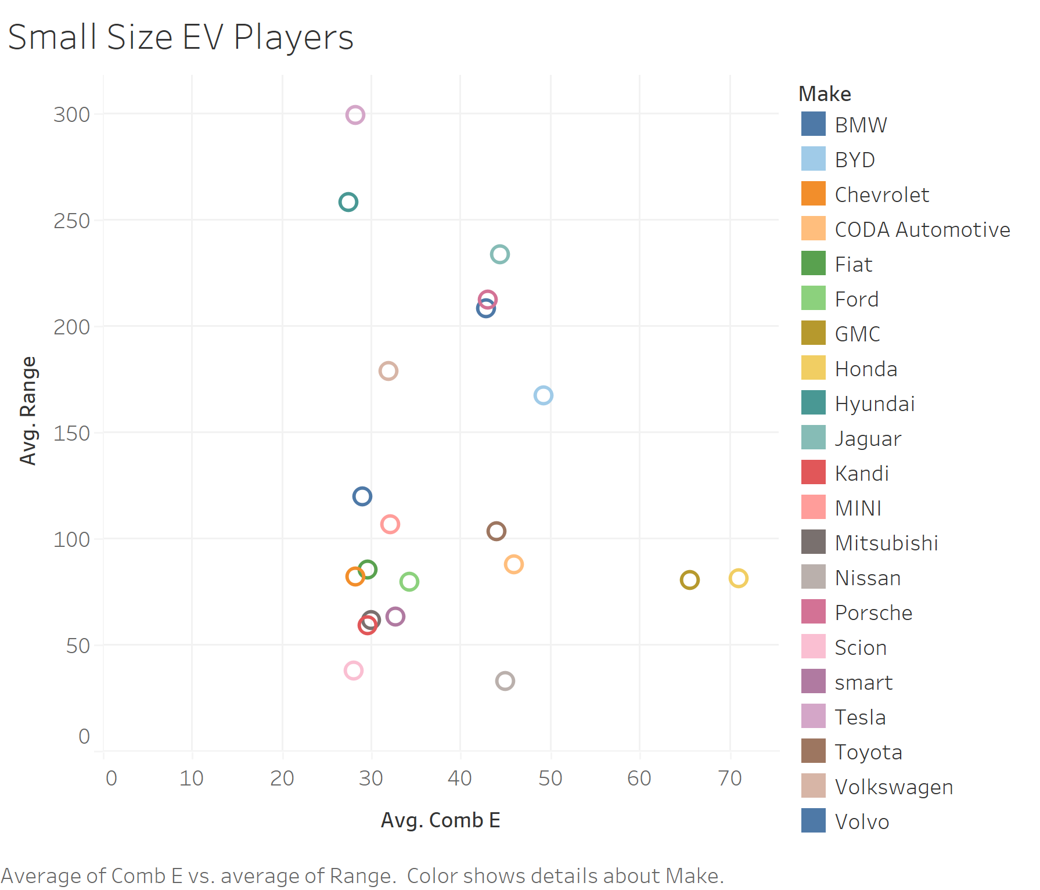
If You Want to Buy a Small EV
Tesla, Hyundai are the best choices. e.g. Model Y, Kona
Jaguar, Volvo and Porche are good but expensive.
Volkswagon for a cheaper option.
Notes:
Presenter : Abhishek

Slide 33
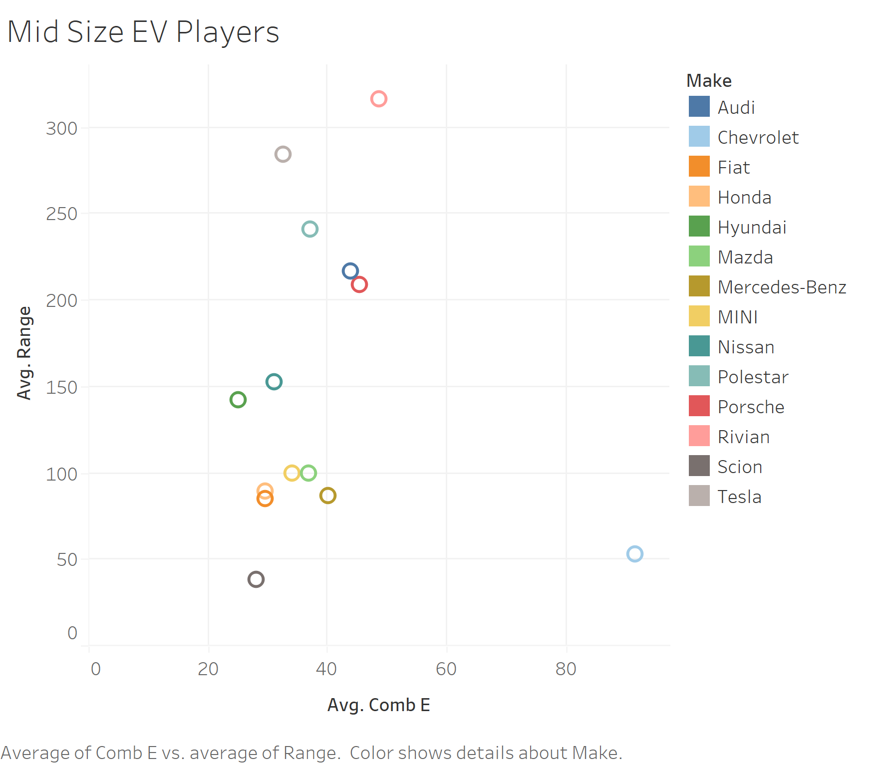
Car for a Small family i.e., Mid-size
Tesla and Polestar are great!
For ex: Model X, Model 3, Polestar 2
As per available data, Chevrolet isn’t a desirable option .
Notes:
Presenter : Abhishek

Slide 34
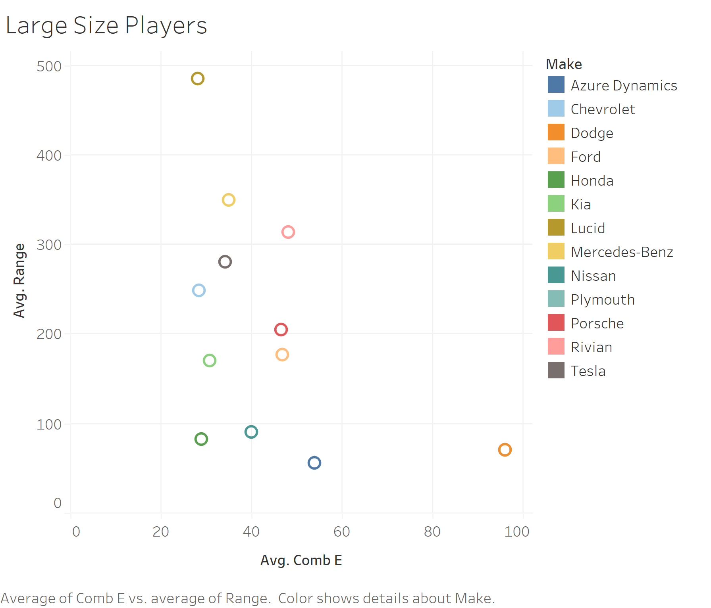
The Big Boys i.e., Large Size Cars/Trucks
Lucid, Merc and Rivian beats Tesla here. E.g., Air Dream P, EQS 450 Plus
Tesla Model S gets a close 2nd place.
Notes:
Presenter : Abhishek

Slide 35
Summary Model Analyses:
In-depth evaluation of EV as a prospective transportation choice for the future was led by driving the research based on critical questions as outlined before.
So, What did we learn after 5 pressing questions to gauge prospects for EV cars as mass transportation?
Analysis Objective | Model/ Solution Technique | Conclusion
EV vs ICE cost Analysis | Linear Regression, | Clearly indicated decreasing cost trend for EVs.
Are EVs sustainable? | Logistic Regression | EV classified into the favorable GHG score category (as per set threshold). Hence, sustainable.
What attributes would determine EV pricing? | Multiple Linear Regression, PCA, PCR | Three regression equation, based on EV categories yielded price predictor equations.
What are the best EV options out there? | Clustering in R, DT and Data analytics in Tableau | Q3 and Q4 busiest sales region. Tesla, BMW, Ford, Toyota, Chevrolet best makers in NJ. For mid Range and pricing bracket Tesla model : X, S and 3 best performers. Similar trends on the US Scale too.
Can similarities between EV be mapped? How to group them? | Regression (Trend analysis) and Clustering in Tableau | As per “CombE” metric, Tesla had best numbers. Best models in mid-size and large-size segment clustered based on Range and CombE metric.
Notes:
Presenter : Patrick

Slide 36

Conclusion and Recommendations
Initial investment on EV are going down at greater rate, favoring buyers.
EV proved to have lower maintenance costs.
Range and Performance aspects such as “Acceleration time”emerged as critical driver in price determination. Also, Model, Maker and Year of manufacturing are important drivers of cost estimation.
Logistic Regression analysis clearly favors EV over ICE as a cleaner alternative.
Clustering helped segment similar models – based on Price vs Range for Rapid charge models. AWD EV in hatchback, Sedan and SUV emerged as most optimal choices in mid price range section.
Tesla clearly leads the EV market in NJ and outshone everyone else in Sales and performance. Other major suppliers are competitive but Tesla captures approx. 50% of the NJ market itself.
Tesla’s Model X, S and 3 capture 46% of NJ market. Q3 and Q4 are best time to buy EV. Tesla is also the most recommended option for mid-size as well as large-EV segment.
DON’T WAIT !!!!
Notes:
Presenter: Mohit

Slide 37
Recommendation for future work
As future project, following avenues can be explored:
Apply more PCA and Classification methods to learn about Energy Consumption aspect (provided reliable data becomes available).
Tax & maintenance benefits from EV purchase could be another metric to add to existing LR models (if credible data is available).
Standardized data source from EV regulatory body driven data management would help get consistent insights. (for ex: Vehicle ‘class type’ is interpreted variedly).
Govt. agencies release annual data after due verification. Thus, discussed models could be enriched with recent data from 2020 and 2021 (as applicable).
Complex models can be experimented by adding more attributes to models.
Discussed results can be expanded to determine metrics for other states besides NJ.
Notes:
Presenter : Phat

Slide 38
Questions?

Slide 39
Thank You!

